Slide 1
ISTA 350 Final Project
Murder Data Scraping and Visualization
By: Arjoneel Dhar

Slide 2
Motivation
As a young child, I grew up in a small town in the state of Maryland. At the time Maryland was infamous for hosting one of the cities with the highest murder rates in the United States; Baltimore, Maryland. Likewise, I wanted to take this opportunity to view the actual murder statistics within Baltimore (city) and the USA, as well as other murder statistics from within Arizona's jurisdictions.

Slide 3
Goals:
Scrape to get html on murder data website
http://www.murderdata.org/p/data-docs.html
Sift through the site data using beautiful soup to find link to csv file
Transform CSV file into pandas dataframe and series for use in figures
Display 3 figures on statistics:
Scatterplot of Number of Murders per Year in the city of Baltimore
Plot of 25 highest murder rate cities in the USA
Plot of murder rates in Arizona.

Slide 4
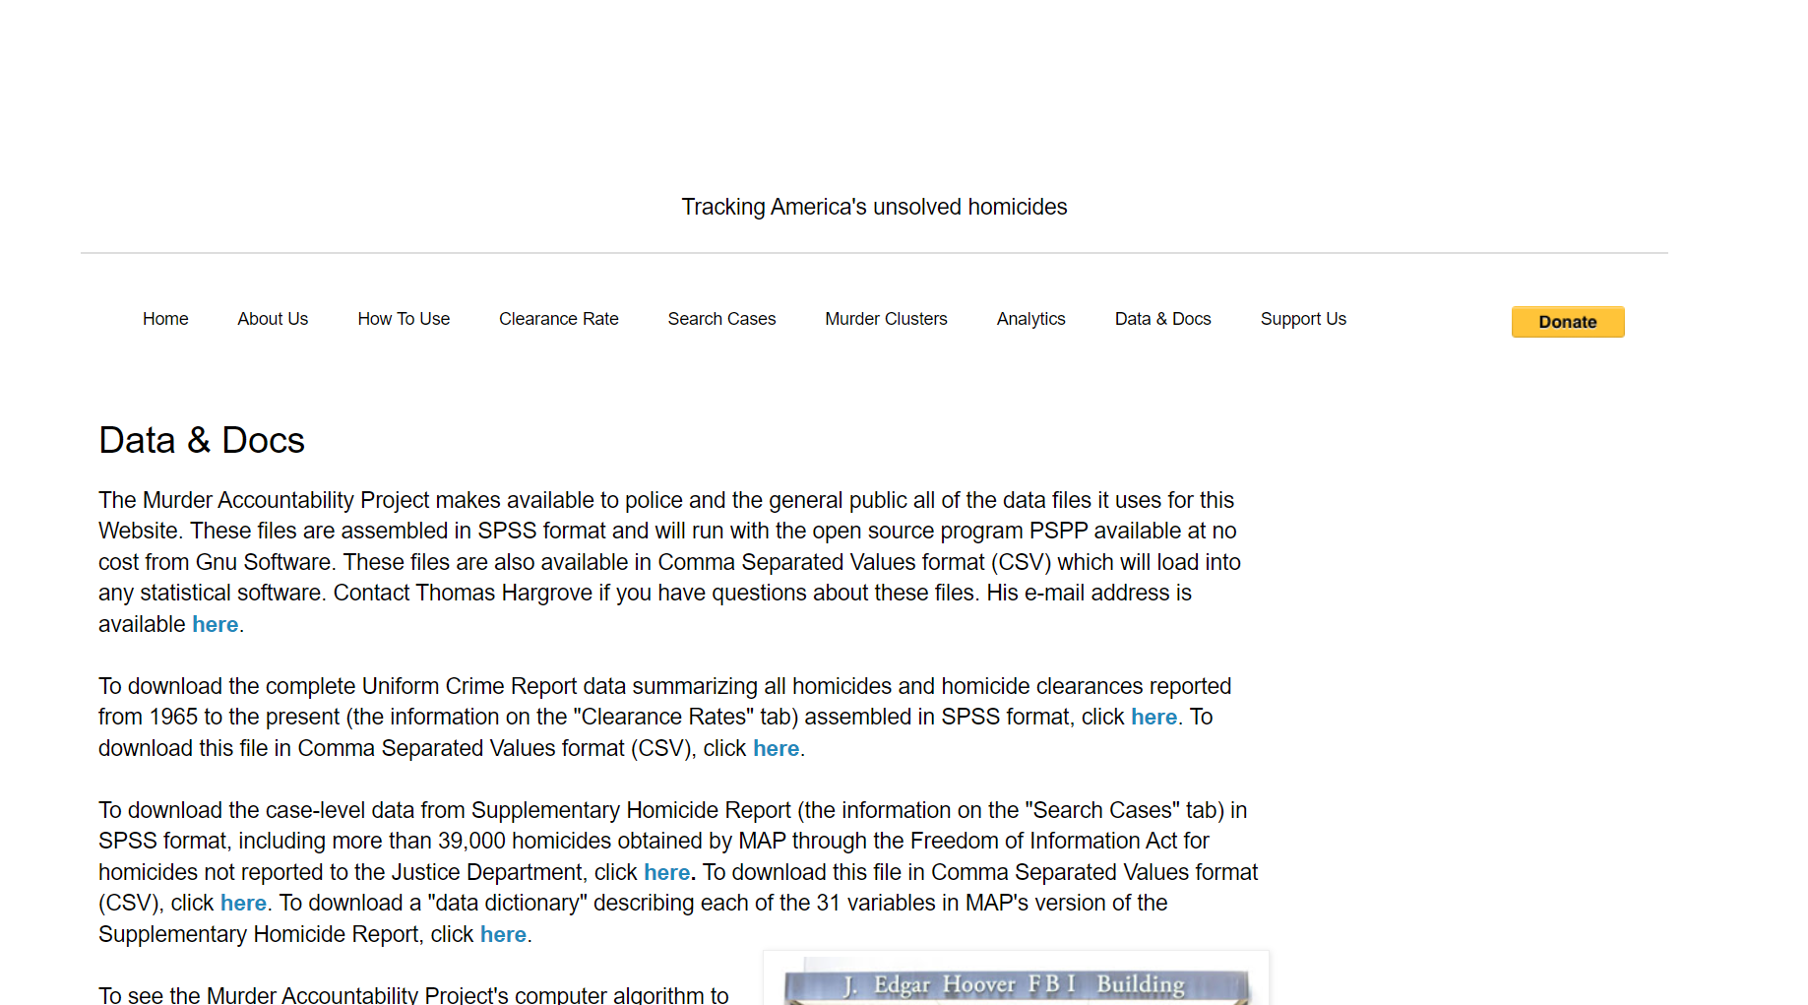

Slide 5
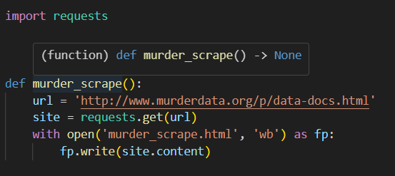

Slide 6
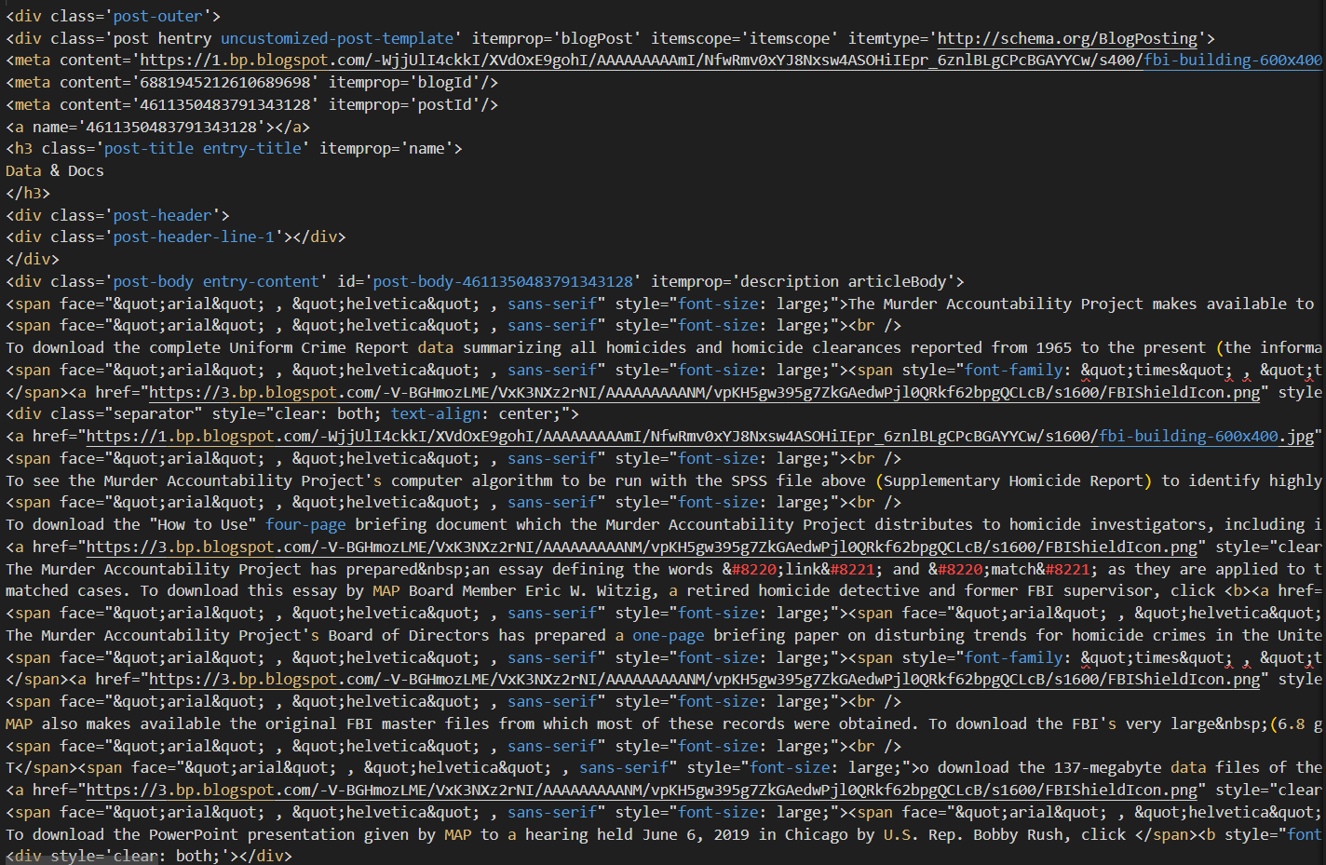

Slide 7
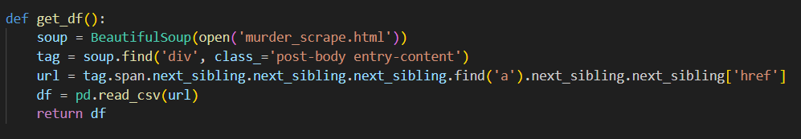
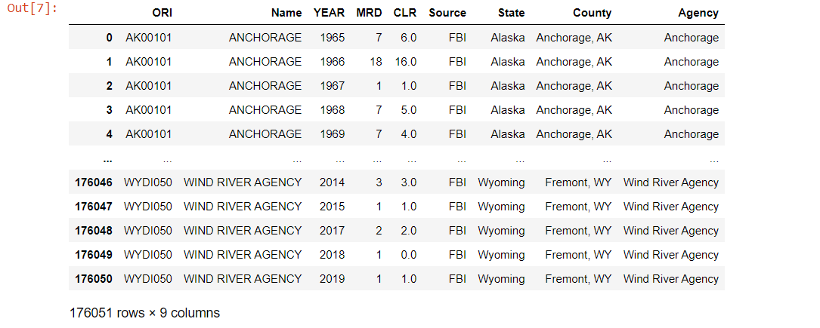

Slide 8
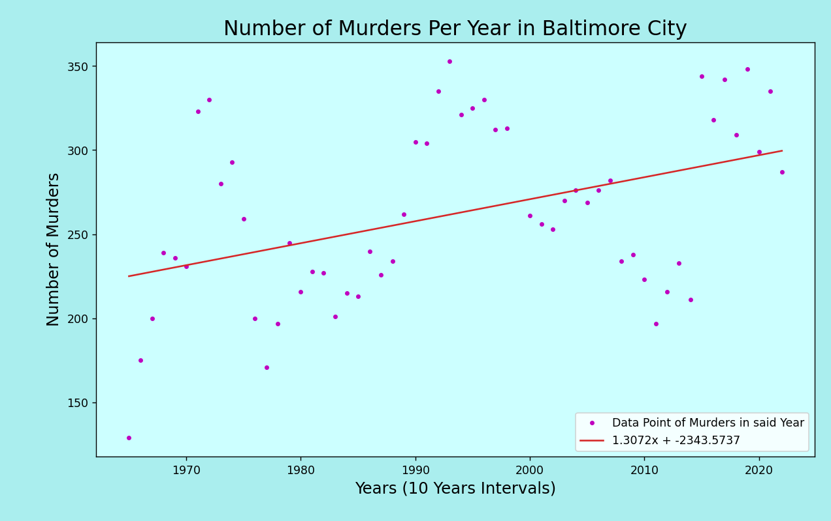

Slide 9
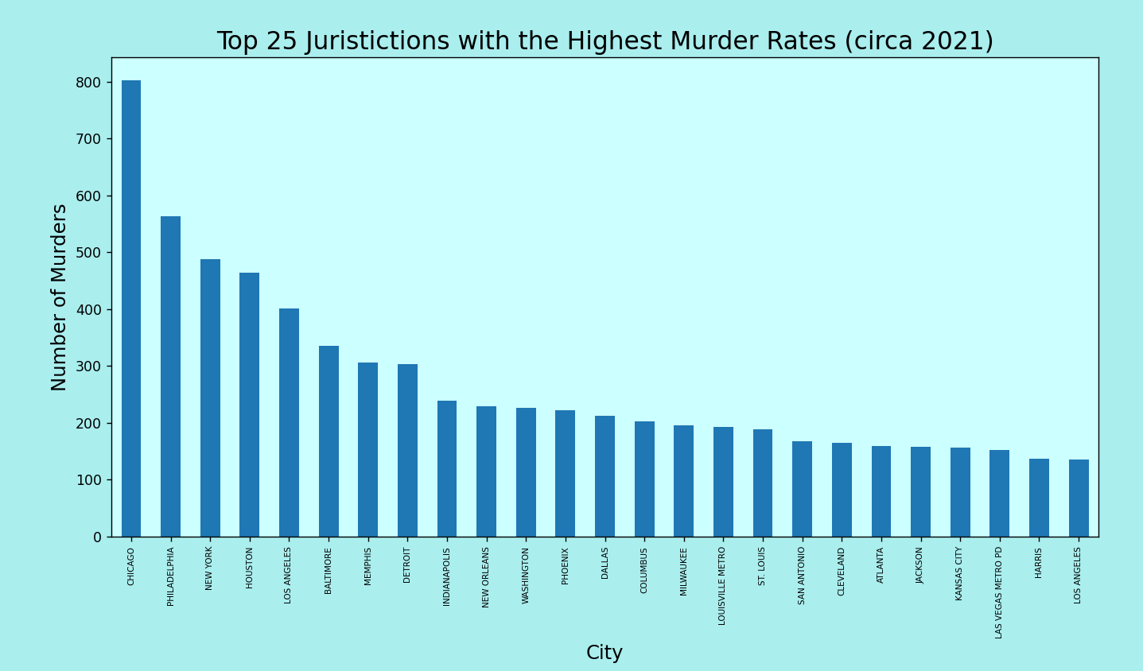

Slide 10
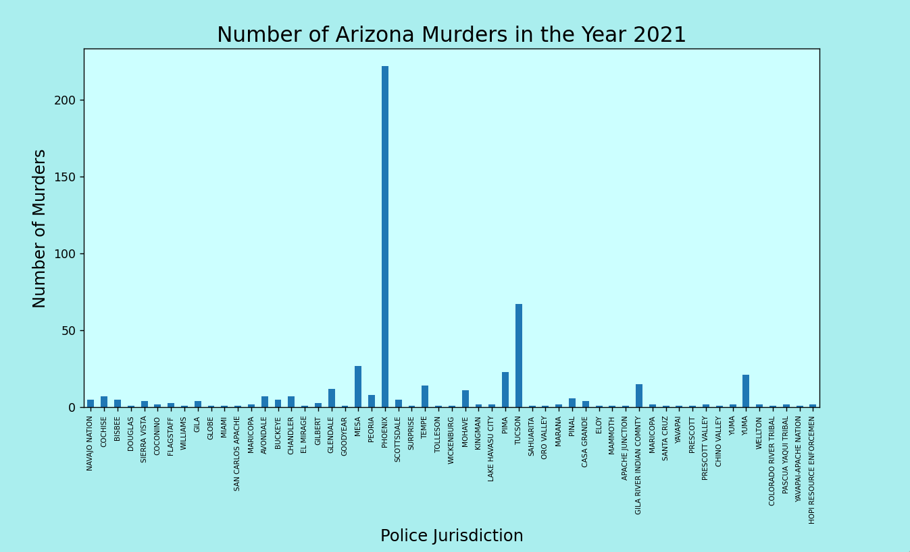

Slide 11
Acknowledgements
Faculty and Staff
Peers
Dr. Rich Thompson
Olivia Fernflores
Sam Cassity
Anushka Bande
Evan Williams
Taaon Fraser

Slide 12
Special Aknowlegments
Chase Hult
Ahmad Arshad

